Slide 1
Histogram

Slide 2
Histogram
informasi penting mengenai isi citra digital
Histogram citra adalah grafik yang menggambarkan penyebaran nilai-nilai intensitas pixel dari suatu citra
Dari sebuah histogram dapat diketahui frekuensi kemunculan relative dari intensitas pada citra

Slide 3
Histogram
Histogram juga dapat menunjukkan banyak hal tentang kecerahan (brightness) dan kontras (contrast) dari sebuah gambar.
histogram adalah alat bantu yang berharga dalam pengolahan citra baik secara kualitatif maupun kuantitatif.

Slide 4
Histogram
Graph showing the number of pixels for each intensity
Normalized histogram: histogram where the number of pixel is divided by the total number of pixel so the range is [0,1]
Cumulative histogram: histogram which shows the number of pixels whose intensity is less or equal to each intensity.

Slide 5
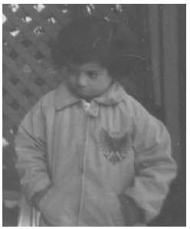
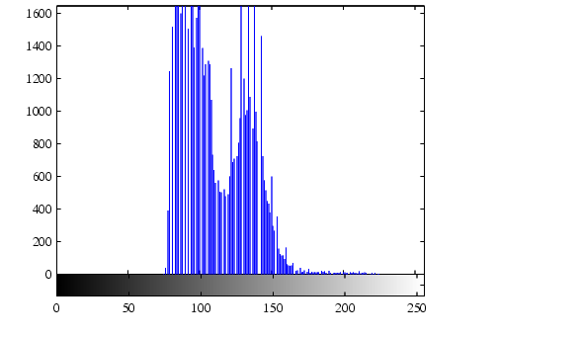
Histogram Example
>> p = imread(‘pout.tif’)
>> inshow(p)
>> figure;imhist(p)

Slide 6
Normalized histogram
Misalkan citra digital memiliki L derajat keabuan, yaitu dari nilai 0 sampai L – 1
citra dengan kuantisasi derajat keabuan 8-bit, nilai derajat keabuan dari 0 sampai 255

Slide 7
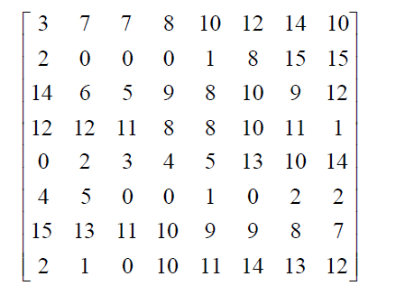
Normalized histogram
citra dijital yang berukuran 8 x 8 pixel dengan derajat keabuan dari 0 sampai 15 (ada 16 buah derajat keabuan)

Slide 8
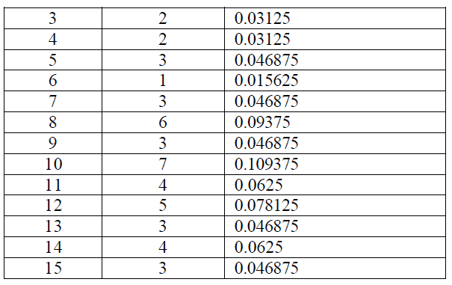
Normalized histogram

Slide 9
Normalized histogram
Nilai h? [0,1]

Slide 10
Cumulative histogram
Nilai h?

Slide 11
What Histogram Describes?
Brightness
dark image has gray levels (histogram) clutered at the lower end.
bright image has gray levels (histogram) clutered at the higher end.
Contrast
well contrasted image has gray levels (histogram) spread out over much of the range.
low contrasted image has gray levels (histogram) clutered in the center.

Slide 12
Contrast Enhancement by Spreading Out Histogram
Histogram Stretching
(Contrast Stretching)
Histogram Equalization

Slide 13
Histogram Stretching

Slide 14
1. Histogram Stretching
#pixel
#pixel
Imin
Imax
I
I
0
max

Slide 15
Steps of Histogram/Contrast Stretching
Create the histogram of the image
Gray level ( i ) No. of gray value ( n_{i} )
0……………………………………………. 15
1……………………………………………. . 0
2……………………………………………. . 0
3……………………………………………. .0
4……………………………………………. . 0
5……………………………………………. 70
6……………………………………………110
7……………………………………………. 45
8…………………………………………… 70
9……………………………………………. 35
10………………………………………..... . 0
11………………………………………….. 0
12…………………………………………... 0
13…………………………………………… 0
14…………………………………………… 0
15………………………………………….. 15
Draw the histogram.

Slide 16
Steps of Histogram/Contrast Stretching (cont)
From the histogram, stretch out the gray levels in the center of the range by applying the piecewise linear function
Ex: [5,9] → [2,14]
y = [(14 – 2)/(9 – 5)](x – 5) + 2, Draw a graph of transformation
Gray levels outside this range are either left as original values or transforming according to the linear function at the ends of the graph.
x y
2
5
8
11
14

Slide 17
Histogram Stretching: Example
original
output

Slide 18
Histogram before/after Adjustment
Before
After

Slide 19
Histogram Mapping: Piecewise Linear
#pixel
#pixel
Imin
Ix1
Ix2
Imax
I
Imin
Iy1
Iy2
Imax
I
Mapping function:

Slide 20
MATLAB: Histogram/Contrast Stretching
Command: imadjust
Syntax: imadjust(x, [a,b], [c,d]);
imadjust(x, [a,b], [c,d], γ);
convert intensity x ≤ a to c
convert intensity x ≥ b to d
values of a,b,c,d must be between 0 and 1
γ : positive constant (describe the shape of the function, < 1 concave downward, > 1 concave upward)

Slide 21
Transformation Function with Gamma (Power –Law Transformation)
Brighten image
Linear mapping
Darken image

Slide 22
Example of Adjusting by the Power-Law Transformation
Original
Adjust by using
Gamma = 0.5

Slide 23
Histogram citra gray-scale

Slide 24
Histogram citra berwarna

Slide 25
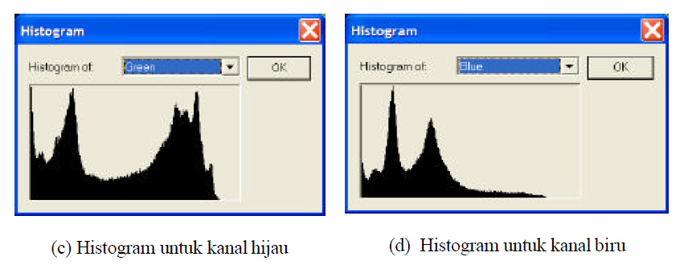
Histogram citra berwarna

Slide 26
Histogram citra terlalu gelap

Slide 27
Histogram citra terlalu terang

Slide 28
Histogram citra bagus

Slide 29
Histogram Equalization

Slide 30
2. Histogram Equalization
The trouble with the methods of histogram stretching is that they require user input.
Histogram equalization is an entirely automatic procedure.
Idea: Each gray level in the image occurs with the same frequency.
Give the output image with uniform intensity distribution.

Slide 31
2. Histogram Equalization
proses perataan histogram, dimana distribusi nilai derajat keabuan pada suatu citra dibuat rata.
Untuk dapat melakukan histogram equalization ini diperlukan suatu fungsi distribusi kumulatif yang merupakan kumulatif dari histogram.

Slide 32
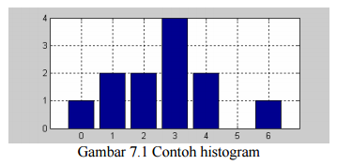
2. Histogram Equalization
Misalkan diketahui data sebagai berikut: 2 4 3 1 3 6 4 3 1 0 3 2

Slide 33
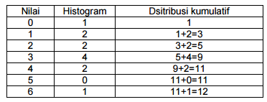
Distribusi Kumulatif

Slide 34
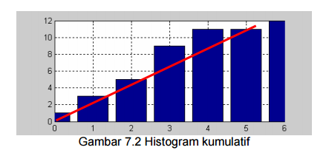
Histogram equalization (perataan histogram) adalah suatu proses dimana histogram diratakan berdasarkan suatu fungsi linier (garis lurus)

Slide 35
Teknik perataan histogram

Slide 36
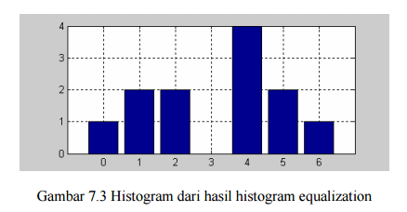
Hasil histogram Equalization
Hasil setelah histogram equalization data sebagai berikut: 2 5 4 1 4 6 5 4 1 0 4 2

Slide 37
Perbandingn Hasil histogram Equalization
data awal: 2 4 3 1 3 6 4 3 1 0 3 2
Data hasil 2 5 4 1 4 6 5 4 1 0 4 2

Slide 38
Histogram Equalization: Example
BEFORE
AFTER
http://www.mathworks.com/access/helpdesk/help/toolbox/images/histeq.html

Slide 39
Histogram Equalization (cont)
Mapping function:
where p(i) is the PDF of the intensity level i,
obtained from cumulative histogram.

Slide 40
MATLAB: Histogram Equalization
Command: histeq
Syntax: histeq(image, target_hist)
histeq(image, #bin)
histeq(indexed_im, #bin, target_hist)
histeq(indexed_im, map, #bin)
Default: #bin = 64
Output: output_im, [output_im, transform], new_map, [new_map, transform]

Slide 41
Video

