Slide 1
Key Stages in
Digital Image Processing
Tahap-tahap Kunci pada
Pemrosesan Citra Digital

Slide 2
Key Stages in Digital Image Processing
Image Restoration
Morphological Processing
Image Enhancement
Segmentation
Image Acquisition
Object Recognition
Representation & Description
Problem Domain
Colour Image Processing
Image Compression

Slide 3


Key Stages in Digital Image Processing:
Image Aquisition
Image Restoration
Morphological Processing
Image Enhancement
Segmentation
Image Acquisition
Object Recognition
Images taken from Gonzalez & Woods, Digital Image Processing (2002)
Representation & Description
Problem Domain
Colour Image Processing
Image Compression

Slide 4
Image Acquisition
Proses penangkapan citra/gambar
Image Acqusition pada manusia dimulai dengan mata
Umumnya pada computer, informasi visual didapat dari kamera.

Slide 5
Image Acquisition
Keluaran dari kamera adalah berupa sinyal analog
Karena komputer bekerja pada domain digital, maka ADC dibutuhkan untuk memproses semua sinyal analog agar bisa diproses

Slide 6
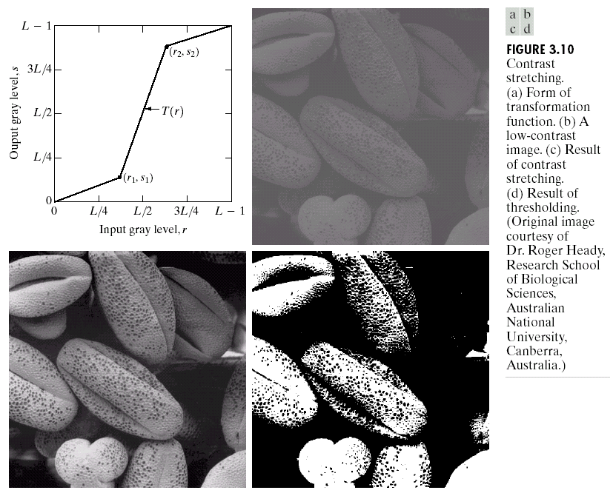
Key Stages in Digital Image Processing:
Image Enhancement
Image Restoration
Morphological Processing
Image Enhancement
Segmentation
Image Acquisition
Object Recognition
Images taken from Gonzalez & Woods, Digital Image Processing (2002)
Representation & Description
Problem Domain
Colour Image Processing
Image Compression

Slide 7
Image Enhancement
adalah proses perbaikan kualitas citra (manipulation of Image)
agar citra menjadi lebih baik 'secara visual' untuk aplikasi tertentu
proses sangat bergantung pada kebutuhan dan pada keadaan citra input
proses image enhancement merupakan ukuran subjektif seseorang.

Slide 8
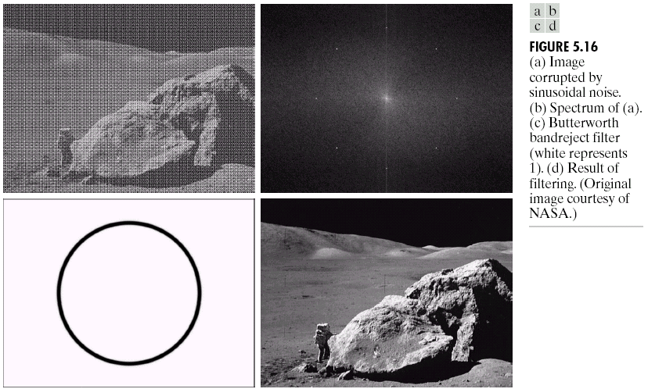
Key Stages in Digital Image Processing:
Image Restoration
Image Restoration
Morphological Processing
Image Enhancement
Segmentation
Image Acquisition
Object Recognition
Images taken from Gonzalez & Woods, Digital Image Processing (2002)
Representation & Description
Problem Domain
Colour Image Processing
Image Compression

Slide 9
Image Restoration
reconstruction of image
memperbaiki suatu citra yang sudah terkena noise
image restoration dilakukan dengan memanfaatkan fungsi matematika dan hasilnya objektif.

Slide 10
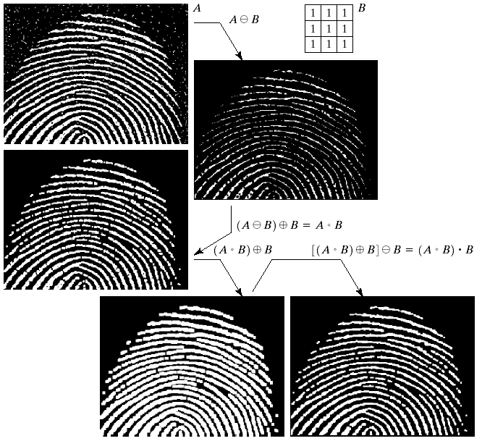
Key Stages in Digital Image Processing:
Morphological Processing
Image Restoration
Morphological Processing
Image Enhancement
Segmentation
Image Acquisition
Object Recognition
Images taken from Gonzalez & Woods, Digital Image Processing (2002)
Representation & Description
Problem Domain
Colour Image Processing
Image Compression

Slide 11
Morphological Processing
teknik pengolahan citra digital dengan bentuk (shape) sebagai pedoman dalam pengolahan.
Nilai dari setiap pixel dalam citra digital diperoleh melalui perbandingan antara pixel yang bersesuaian dengan pixel tetangganya.
morphologi sesuai digunakan untuk melakukan pengolahan binary image dan grayscale image.

Slide 12
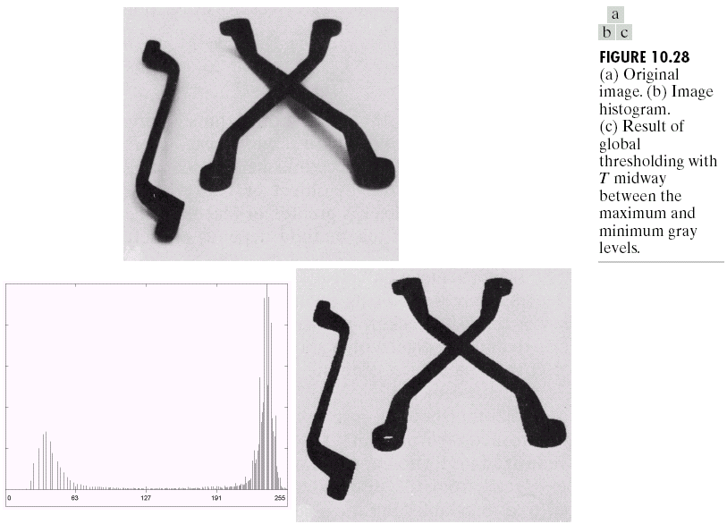
Key Stages in Digital Image Processing:
Segmentation
Image Restoration
Morphological Processing
Image Enhancement
Segmentation
Image Acquisition
Object Recognition
Images taken from Gonzalez & Woods, Digital Image Processing (2002)
Representation & Description
Problem Domain
Colour Image Processing
Image Compression

Slide 13
Segmentation
membagi citra menjadi wilayah-wilayah yang homogen berdasarkan kriteria keserupaan tertentu antara tingkat keabu-abuan suatu piksel dengan tetangganya.
Segmentasi sering dideskripsikan sebagai proses pemisahan latar depan dan latar belakang.

Slide 14
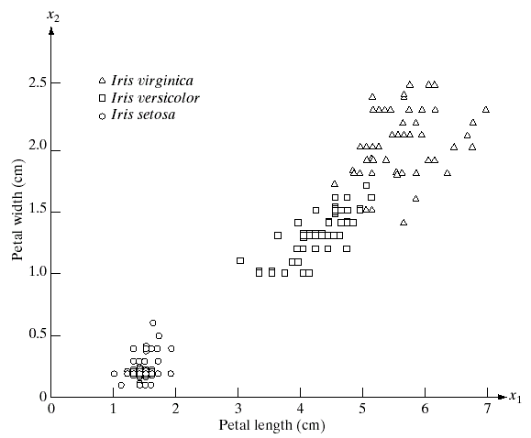
Key Stages in Digital Image Processing:
Object Recognition
Image Restoration
Morphological Processing
Image Enhancement
Segmentation
Image Acquisition
Object Recognition
Images taken from Gonzalez & Woods, Digital Image Processing (2002)
Representation & Description
Problem Domain
Colour Image Processing
Image Compression

Slide 15
Object Recognition
Pengenalan obyek adalah kemampuan untuk merasakan sifat fisik suatu objek (seperti bentuk, warna dan tekstur)

Slide 16
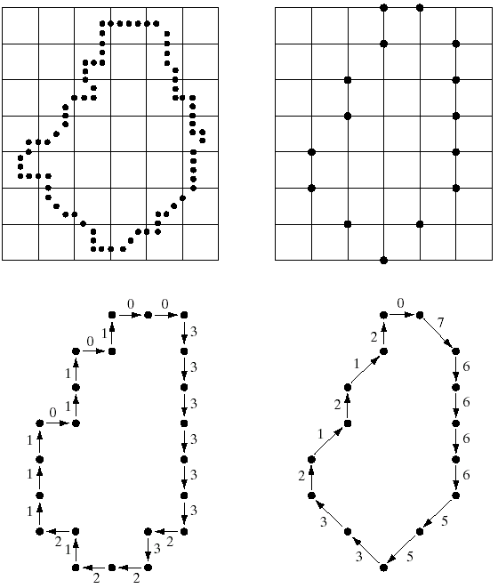
Key Stages in Digital Image Processing:
Representation & Description
Image Restoration
Morphological Processing
Image Enhancement
Segmentation
Image Acquisition
Object Recognition
Images taken from Gonzalez & Woods, Digital Image Processing (2002)
Representation & Description
Problem Domain
Colour Image Processing
Image Compression

Slide 17
Representation & Description
proses menampilkan citra dengan cara mencacah citra tersebut dalam bentuk titik – titik warna yang ditandai dengan angka sebagai tingkat kecerahan warna
kemudian dipetakan dengan :
koordinat matriks = letak suatu titik pada citra asli
koordinat piksel = letak suatu titik pada citra di layar monitor

Slide 18
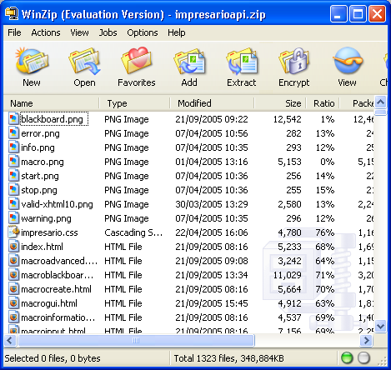
Key Stages in Digital Image Processing:
Image Compression
Image Restoration
Morphological Processing
Image Enhancement
Segmentation
Image Acquisition
Object Recognition
Representation & Description
Problem Domain
Colour Image Processing
Image Compression

Slide 19
Image Compression
kompresi citra digital untuk mengurangi redundansi data-data yang terdapat dalam citra sehingga dapat disimpan atau ditransmisikan secara efisien.
meminimalkan kebutuhan memori dengan mengurangi duplikasi data di dalam citra

Slide 20
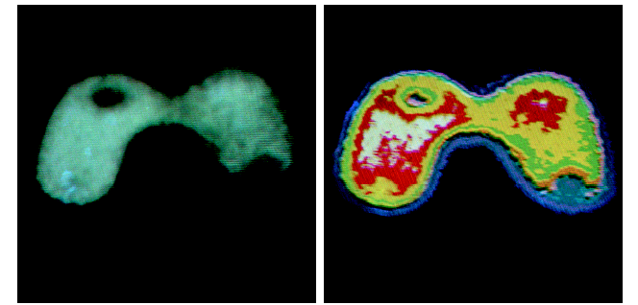
Key Stages in Digital Image Processing:
Colour Image Processing
Image Restoration
Morphological Processing
Image Enhancement
Segmentation
Image Acquisition
Object Recognition
Images taken from Gonzalez & Woods, Digital Image Processing (2002)
Representation & Description
Problem Domain
Colour Image Processing
Image Compression

Slide 21
Colour Image Processing
Proses pewarnaan citra untuk memudahkan dalam mengolah citra

Slide 22
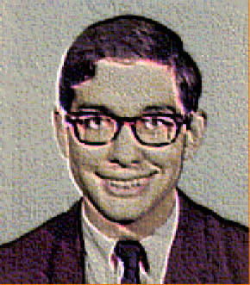
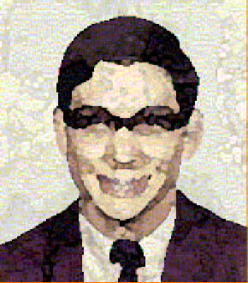
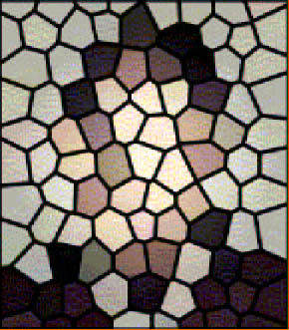
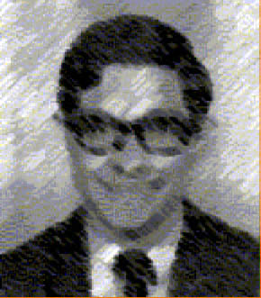
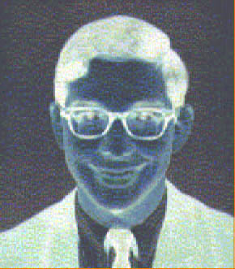
Applications and Research Topics

Slide 23
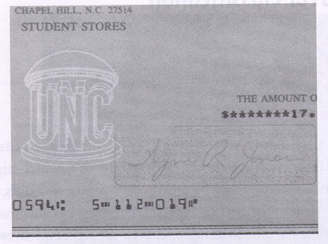
Document Handling

Slide 24

Signature Verification

Slide 25
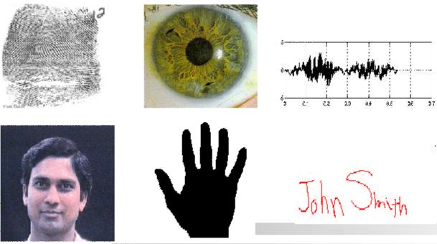
Biometrics

Slide 26
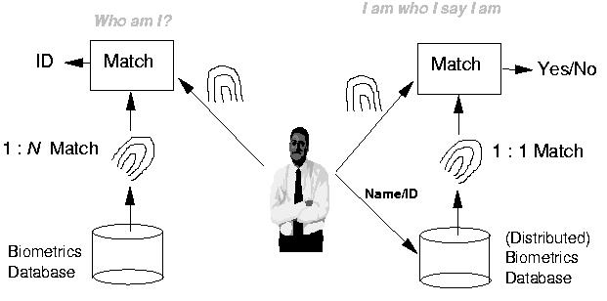
Fingerprint Verification / Identification

Slide 27

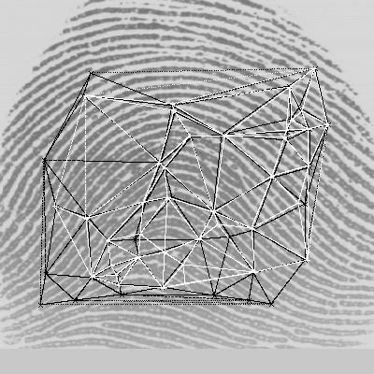
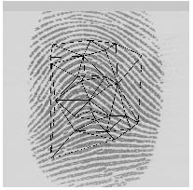
Fingerprint Identification Research at UNR
Minutiae Matching
Delaunay Triangulation

Slide 28

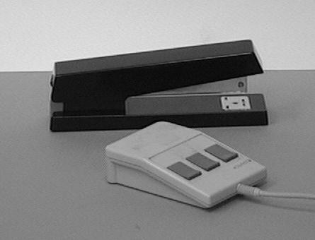
Object Recognition

Slide 29
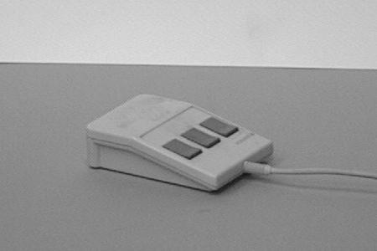
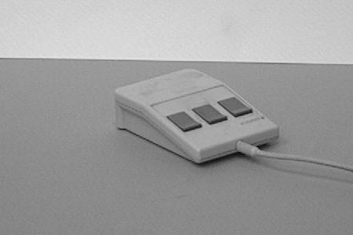
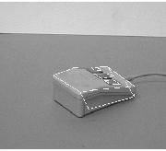
Object Recognition Research
reference view 1 reference view 2
novel view recognized

Slide 30
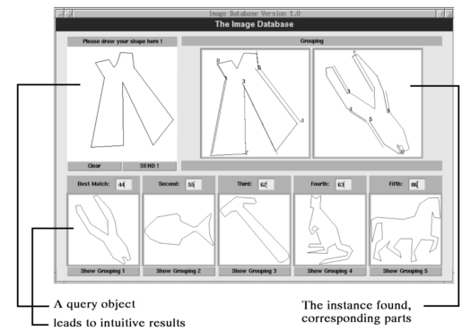
Indexing into Databases
Shape content

Slide 31
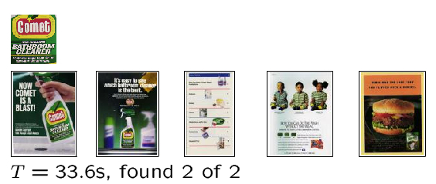
Indexing into Databases (cont’d)
Color, texture

Slide 32
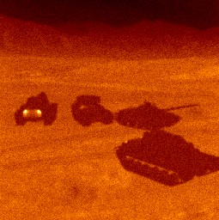
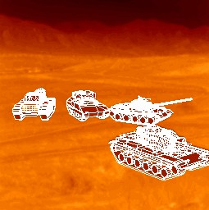
Target Recognition
Department of Defense (Army, Airforce, Navy)

Slide 33
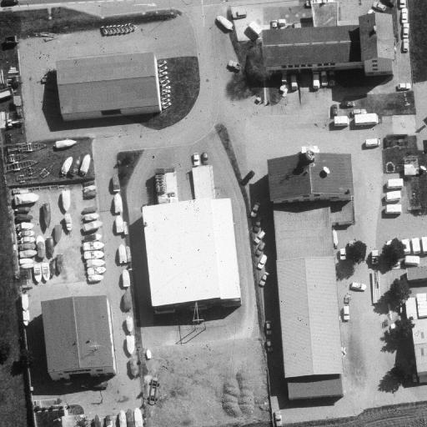
Interpretation of Aerial Photography
Interpretation of aerial photography is a problem domain in both computer vision and registration.

Slide 34
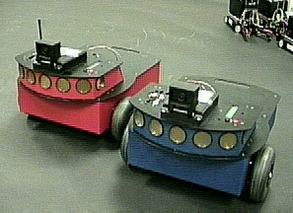
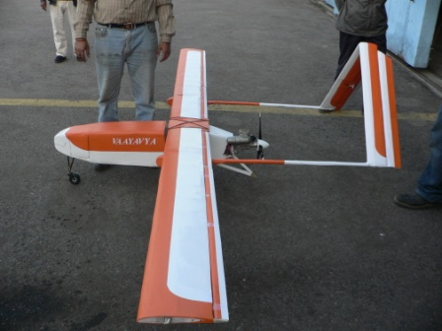
Autonomous Vehicles
Land, Underwater, Space

Slide 35
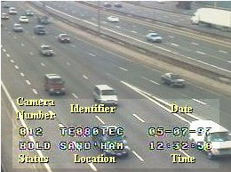
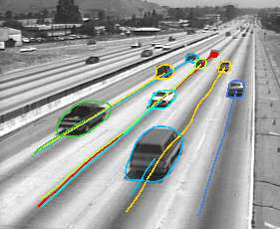
Traffic Monitoring

Slide 36
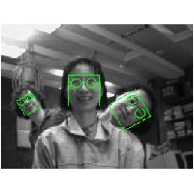
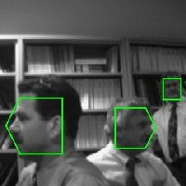
Face Detection

Slide 37
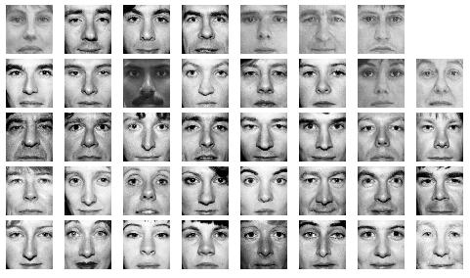
Face Recognition

Slide 38
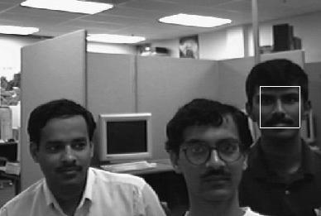
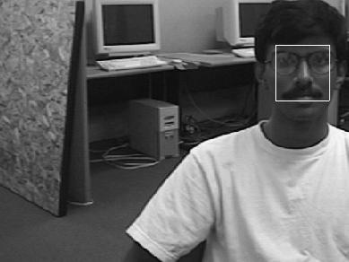
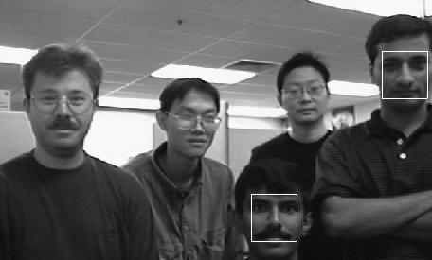
Face Detection/Recognition Research at UNR

Slide 39
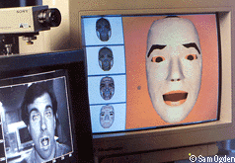
Facial Expression Recognition

Slide 40
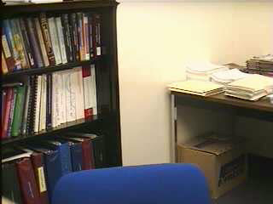

Face Tracking

Slide 41


Face Tracking (cont’d)

Slide 42
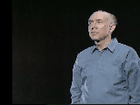
Hand Gesture Recognition
Smart Human-Computer User Interfaces
Sign Language Recognition

Slide 43
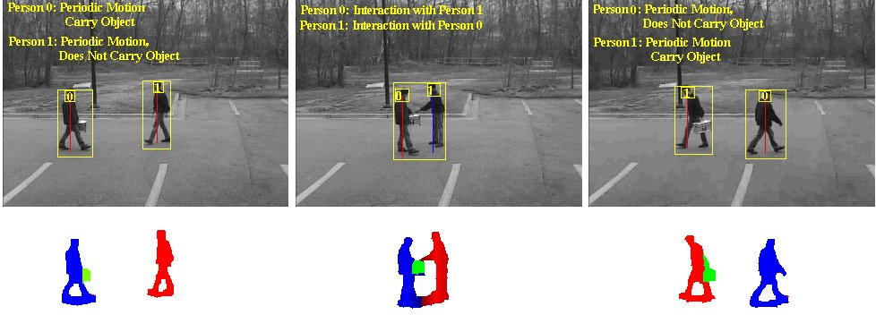
Human Activity Recognition

Slide 44
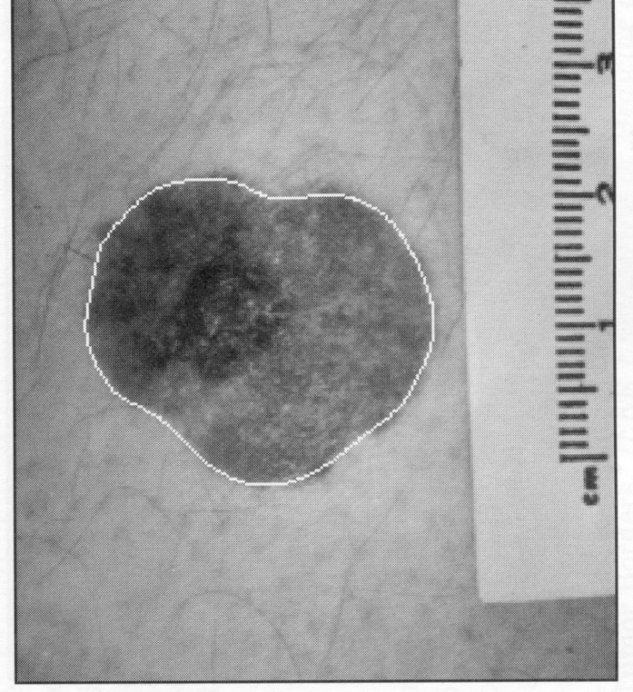
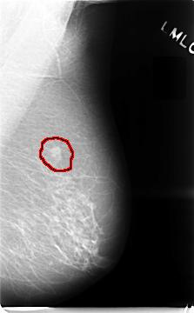
Medical Applications
skin cancer breast cancer

Slide 45
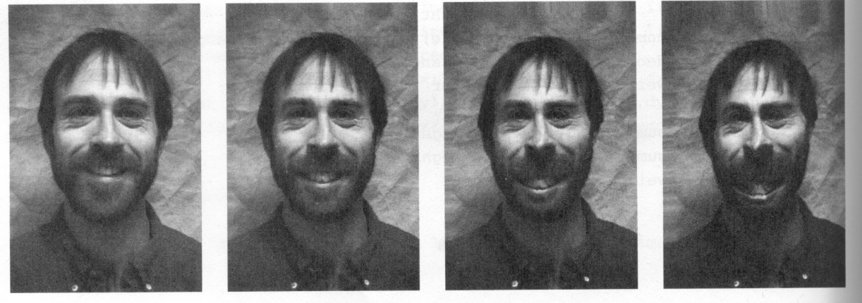
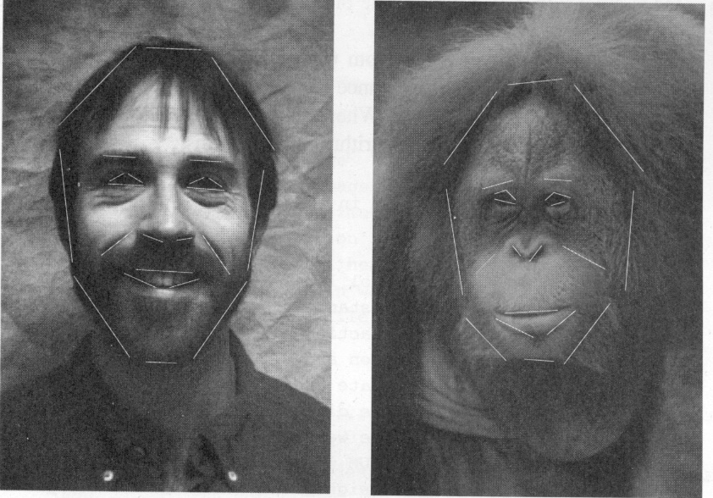
Morphing

Slide 46
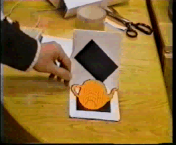
Inserting Artificial Objects into a Scene

Slide 47
Introduction to
Image Processing
Representasi Citra
Tahap-Tahap Kunci pada Image Processing
Aplikasi dan Topik Penelitian pada Image Processing

Slide 48
Image Representation
Representasi Citra

Slide 49
Images are Ubiquitous
Input
  Optical photoreceptors
  Digital camera CCD array
Output
  TVs
  Computer monitors
  Printers

Slide 50
Image Formation
Pembentukan citra :
Geometri
Fisika Cahaya

Slide 51
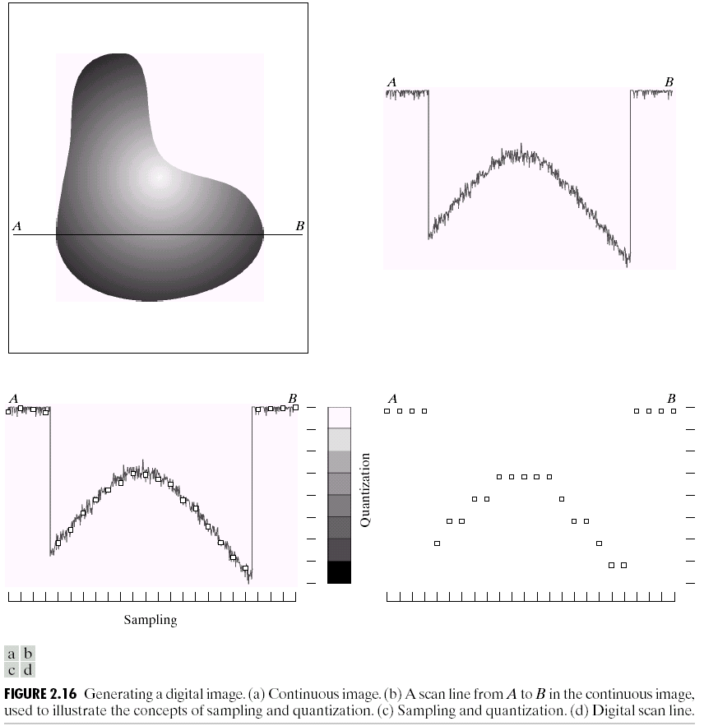
Sampling and Quantization

Slide 52

Sampling and Quantization

Slide 53
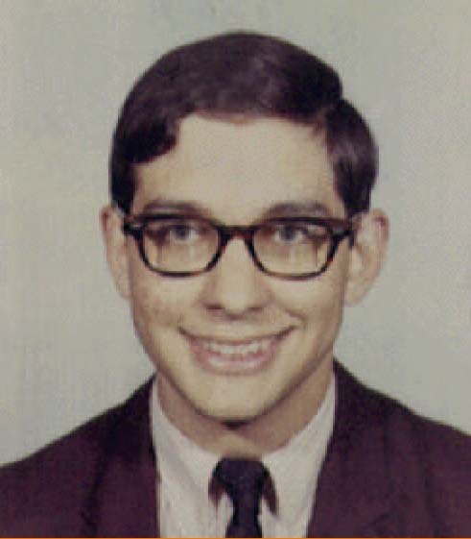

Image as Array of Pixels
An image is a 2-d rectilinear array of pixels

Slide 54

Pixels as samples
A pixel is a sample of a continuous function

Slide 55
What is an image?
The bitmap representation
Also called “raster or pixel maps” representation
An image is broken up into a grid (pixel)
y
Gray level
x
pixel
Original picture
Digital image
f(x, y)
I[i, j] or I[x, y]

Slide 56
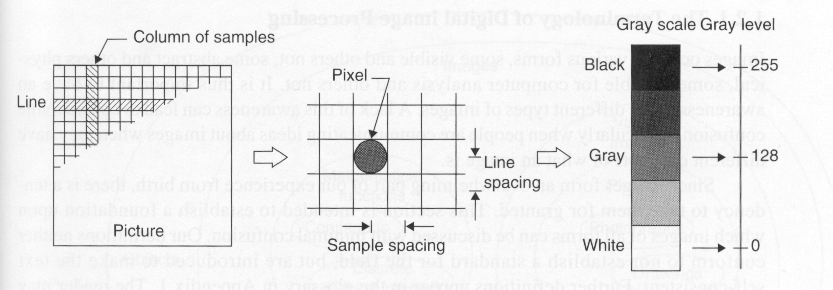
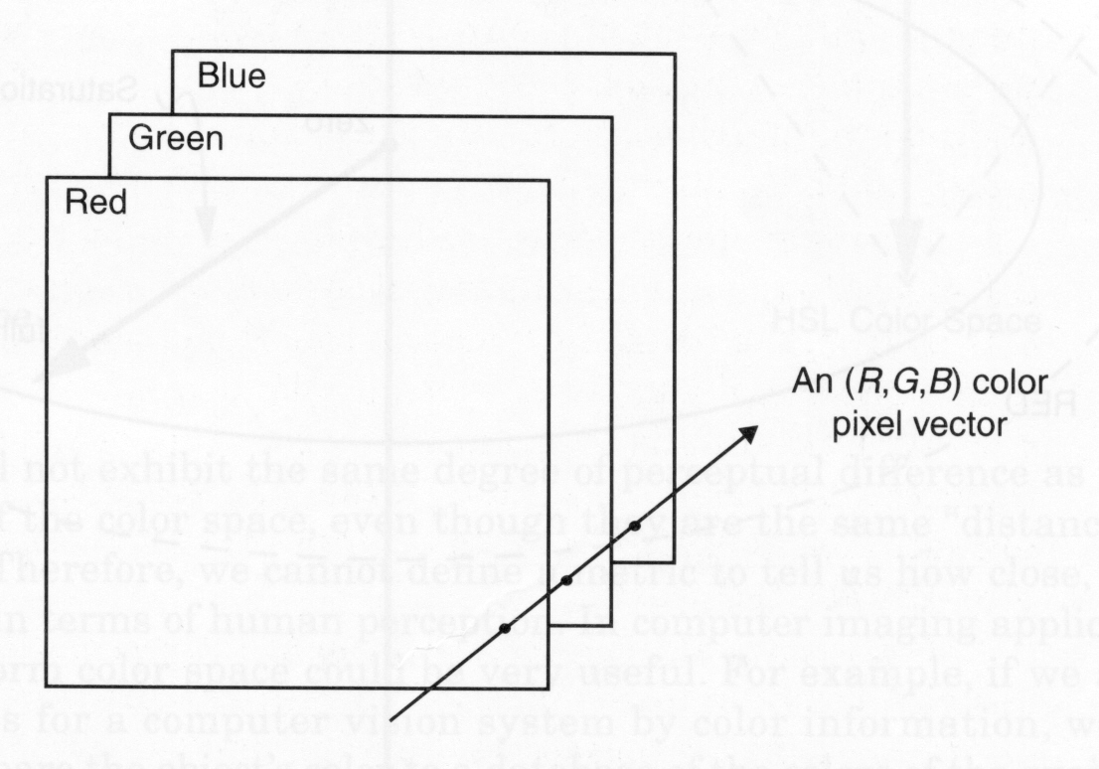
What is an image?
The bitmap representation

Slide 57
What is an image?
The vector representation
Object-oriented representation
Does not show information of individual pixel, but information of an object (circle, line, square, etc.)
Circle(100, 20, 20)
Line(xa1, ya1, xa2, ya2)
Line(xb1, yb1, xb2, yb2)
Line(xc1, yc1, xc2, yc2)
Line(xd1, yd1, xd2, yd2)

Slide 58




Comparison between
Bitmap Representation and Vector Representation
Bitmap
  Can represent images with complex variations in colors, shades, shapes.
  Larger image size
  Fixed resolution
  Easier to implement
Vector
  Can only represent simple line drawings (CAD), shapes, shadings, etc.
  Efficient
  Flexible
  Difficult to implement

Slide 59
Image as a Function
We can think of an image as a function, f, from R² to R:
  f( x, y ) gives the intensity at position ( x, y )
  Realistically, we expect the image only to be defined over a rectangle, with a finite range:
    f: [a,b]x[c,d] → [0,1]
A color image is just three functions pasted together. We can write this as a “vector-valued” function:
Notes:
As opposed to [0..255]

Slide 60
Image as a function
Notes:
Render with scanalyze????

Slide 61
Properties of Images
Spatial resolution
  Width pixels / width cm and height pixels / height cm
Intensity resolution
  Intensity bits/intensity range (per channel)
Number of channels
  RGB is 3 channels, grayscale is one channel

Slide 62
Common image file formats
GIF (Graphic Interchange Format) -
PNG (Portable Network Graphics)
JPEG (Joint Photographic Experts Group)
TIFF (Tagged Image File Format)
PGM (Portable Gray Map)
FITS (Flexible Image Transport System)

Slide 63
Point Processing
Basic Image Processing Operations
Arithmetic Operations
Histograms

Slide 64
Basic Image Processing Operations
Image-Processing operations may be divided into 3 classes based on information required to perform the transformation.
Transforms
  process entire image as one large block
Neighborhood processing
  process the pixel in a small neighborhood of pixels around the given pixel.
Point operations
  process according to the pixel’s value alone (single pixel).

Slide 65
Schema of Image Processing
Image
Transformed Image
Transform
Image-processing operation
Output
Image
Processed Transformed Image
Inverse Transform

Slide 66
Point Operations Overview
Point operations are zero-memory operations where
a given gray level x∈[0,L] is mapped to another
gray level y∈[0,L] according to a transformation
output
y
L
x
L
input
L=255: for grayscale images

Slide 67
Point Operations
Addition
Subtraction
Multiplication
Division
Complement

Slide 68
Arithmetic Operations (cont)
Let x is the old gray value, y is the new gray value,
c is a positive constant.
Addition: y = x + c
Subtraction: y = x - c
Multiplication: y = cx
Division: y = x/c
Complement: y= 255 - x

Slide 69
Arithmetic Operations (cont)
To ensure that the results are integers in the range [0, 255],
the following operations should be performed
  Rounding the result to obtain an integer
  Clipping the result by setting
    y = 255 if y > 255
    y = 0 if y < 0

Slide 70
Arithmetic Operations (cont)
MATLAB functions
  Addition: imadd(x,y)
    Add two images or add constant to image
  Subtraction: imsubstract(x,y)
    Subtract two images or subtract constant to image
  Multiplication: immultiply(x,y)
    Multiply two images or multiply image by constant
  Division: imdivide(x,y)
    Divide two images or divide image by constant
  Complement: imcomplement(x)

Slide 71
Addition & Subtraction
Lighten/darken the image
Some details may be lost
MATLAB:
  commands:
    x = imread(‘filename.ext’);
    y = uint8(double(x) + c); or
    y = uint8(double(x) - c);
  function:
    x = imread(‘filename.ext’);
    y = imadd(x, c); or
    y = imsubtract(x, c);

Slide 72



Ex: Addition & Subtraction
Added by 128
Subtracted by 128

Slide 73
Multiplication & Division
Lighten/darken the image
Some details may be lost (but less than addition/subtraction)
MATLAB:
  commands:
    x = imread(‘filename.ext’);
    y = uint8(double(x)*c); or
    y = uint8(double(x)/c);
  functions:
    x = imread(‘filename.ext’);
    y = immultiply(x, c); or
    y = imdivide(x, c);

Slide 74


Ex: Multiplication & Division
Multiplied by 2
Divided by 2

Slide 75
Comparison: Addition VS Multiplication

Slide 76
Comparison: Subtraction VS Division

Slide 77
Complement
Create the negative image
MATLAB:
  commands:
    x = imread(‘filename.ext’);
    y = uint8(255 - double(x));
  function:
    x = imread(‘filename.ext’);
    y = imcomplement(x);

Slide 78

Ex: Complement

Slide 79


Digital Negative
y
nilai hasil selalu berlawanan,
input putih = output hitam
dan sebaliknya
L
x
0
L

Slide 80

Contrast Stretching
y_{b}
y_{a}
a
b
x
0
L
yang terang, ditambah terang
yang gelap, ditambah gelap

Slide 81

Clipping
a
b
x
0
L

Slide 82

Range Compression
x
0
L
image yang diproses jauh melampaui kemampuan display dari alat.
Solusinya adalah dengan transformasi nilai pixel menggunakan skala yang konstan.
c=100

